Slide 1
Bharat National Bank – Branch Profitability Analysis (2023)

Slide 2

INTRO
Banks operate multiple branches that differ in profitability, efficiency, and customer service.
Management needs clear insights to identify strong and weak branches.
This analysis evaluates profitability and efficiency across multiple bank branches.

Slide 3


AGENDA
Leverage Power BI to analyze Bharat National Bank’s branch-level financial data and derive actionable insights into profitability, operational efficiency, and customer engagement across Different regions of India.

Slide 4
Scope of Analysis
• 50 bank branches across India.
• 12 months of financial and operational data.
• Metrics include deposits, loans, profit, satisfaction, and operating costs.

Slide 5
Problem Statement
Bharat National Bank wants to understand the profitability of its branches across India and identify key factors affecting financial performance. The goal is to analyze regional profit distribution, branch efficiency, cost behavior, and overall profitability trends to support better strategic decision-making.

Slide 6
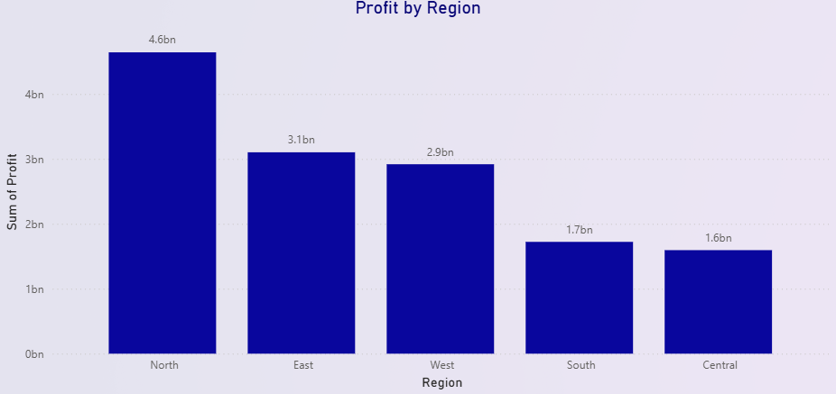
This chart answers:
“Which regions generate the most profit?”
North region contributes the highest profit (4.6bn).
East and West regions follow next.
South and Central perform the lowest.
📌 This helps management focus on high-performing regions and improve weak zones.

Slide 7
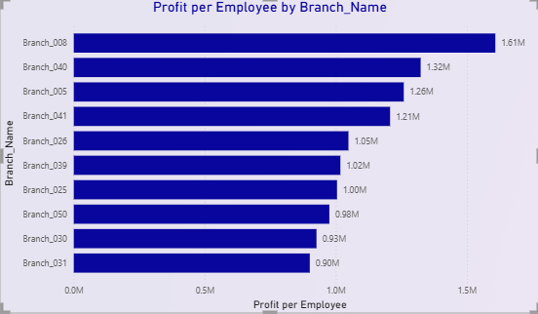
This chart answers:
“Which branches generate the highest profit per employee?”
Highest-ranking branches (like Branch_008, Branch_040) produce more profit per employee,
indicating better workforce efficiency.
The bottom bars represents the branch with the lowest profit per employee in the list.
📌 Helps management identify high-productivity branches and detect branches where staffing or efficiency improvements are needed

Slide 8
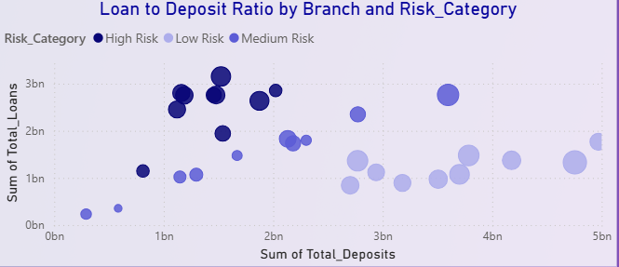
This chart answers:
“How do deposits compare to loan values across branches, and how does risk vary?”
Dark Blue = High Risk branches.
Medium Blue = Medium Risk branches.
Light Blue = Low Risk branches.
📌 Useful for aligning risk management and credit policy.

Slide 9
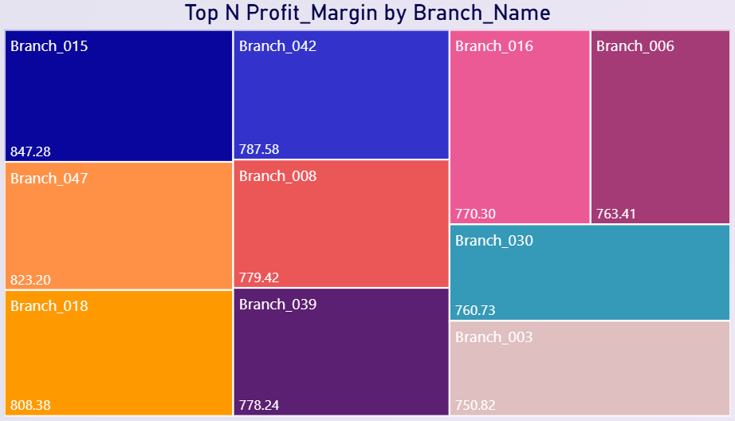
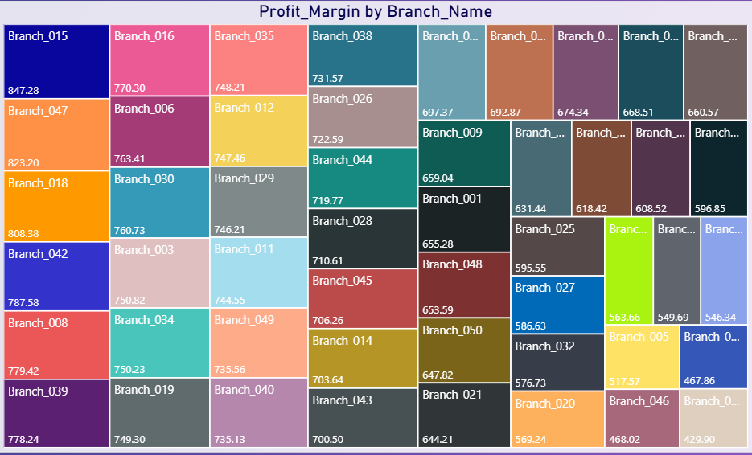
This chart answers:
“Which branches are the top contributors to overall bank profitability?”
The largest boxes represent branches with the highest profit.
Mid-sized boxes show branches with good profitability.
Smaller boxes show branches that barely
made it into the high-performing group.
📌This helps leadership quickly identify which branches consistently drive the bank’s revenue.

Slide 10
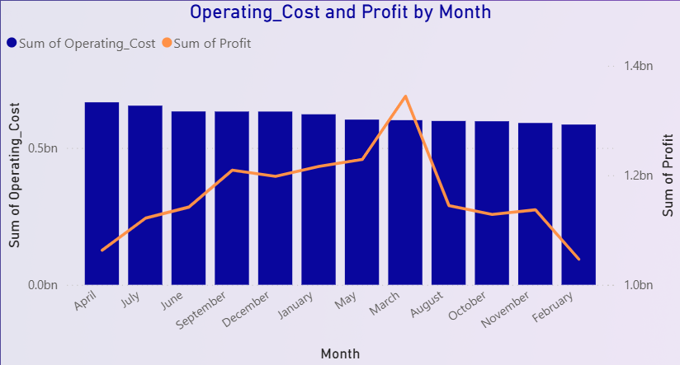
This chart answers:
“How do monthly operating costs compare with monthly profit throughout the year?”
Certain months show higher profit even with moderate operating cost, indicating strong revenue generation.
In some months, operating cost is high but profit is low, which signals inefficiencies or weak
lending performance.
📌 Essential for understanding financial performance trends over time.

Slide 11
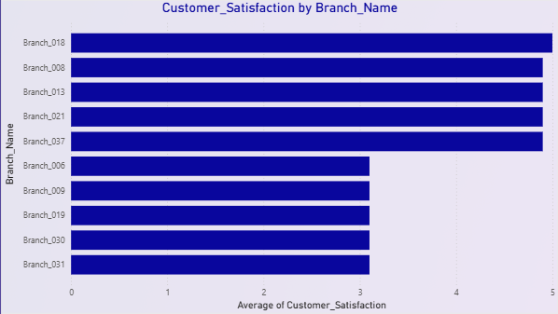
This chart answers:
“Which branches have the highest and lowest customer satisfaction scores?”
Top branches reflect good service quality and customer experience.
Bottom branches indicate areas needing staff training, process improvement, or customer service review.
📌 Useful for benchmarking and improving customer experience strategy.

Slide 12
Recommendations
 | Strengthen risk control for over-leveraged branches.
 | Increase investment in high-performing regions.
 | Provide operational support to weaker branches.
 | Improve customer experience to reduce default rates.

Slide 13

Conclusion
The analysis reveals that the bank must now shift its focus from merely generating aggregate profit to enforcing consistent efficiency (addressing low Profit Margins and poor Profit per Employee ratios) and stabilizing lending practices (intervening in branches with high Loan Default Rates) to ensure sustainable financial growth across the entire network.

Slide 14
THANK YOU
Rukhsar Shirgaonkar

